Slide 1
WEEK 31
Walk, run and jump: the first R1 skills
plus: switching between two skills, and the paper went to L4DC
tests run 2026-10-20 to 2026-10-23 -- simulation only
Notes:
**Time: 20 seconds.**
Last week I proposed a bag of R1 skills that I can chain in a MuJoCo game. You set the first milestone: walk, run and jump, connected smoothly. This week I worked on exactly that. Everything you will see is simulation; nothing ran on the real R1, because the safety gantry has not arrived.

Slide 2
What I set out to answer
Three questions this week
1. Can one trained motion hand over to another?
2. Can the R1 walk and run on command?
3. Can a jump come from a video?
The game needs the R1 to switch between skills.
Before training anything new, I tested a switch between two policies I already had: tennis and dance.
I trained a policy that follows a speed command and stands still at zero.
Then I tested how much command delay it survives, the same test as in my paper.
I sent two jump clips through my video-to-R1 pipeline without changing it, and checked the result in a second simulator.
Three words I use: Policy = the trained controller that turns what the robot senses into motor commands. Command delay = a motor command that arrives late. Sim2sim = testing the same policy in a second, separate simulator.
Notes:
**Time: 45 seconds.**
Three questions. One: can one trained motion hand over to another, because the game needs switching. Two: can the R1 walk and run when I give it a speed, and does that survive command delay. Three: can a jump come out of my video pipeline. Together they are the first milestone. Three words I will use all the time, at the bottom: a policy is the trained controller that turns what the robot senses into motor commands; command delay is a motor command that arrives late; and sim2sim means testing the same policy in a second, separate simulator. I'll go through the questions in this order.

Slide 3
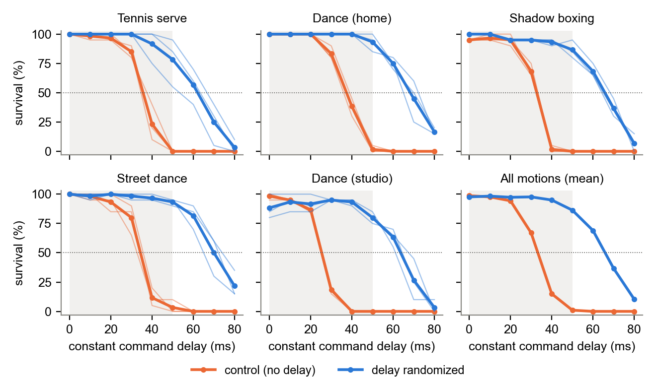
The paper went to L4DC
Submitted; this week's results can go into a later, longer version
How Much Command Delay Can a Learned Humanoid Motion Tracker Tolerate?
From the paper: five R1 motions from video, three training seeds each, tested in a second simulator.
With 40 ms of command delay, survival fell to 15 % on average. With a random 0-50 ms delay in training, it was 95 %.
The same amount of extra training without delay did not help, so the gain comes from the delay itself.
Orange = no delay in training. Blue = random 0-50 ms delay in training. The shaded band is the training range.
Why it matters: practising with delay is the fix I reuse this week, on walking and on a jump.
Notes:
**Time: 60 seconds.**
The paper is submitted to L4DC; the numbers on this slide are the paper's. Its question: how much command delay can a learned motion tracker take? Five motions from video, three seeds each, checked in a second simulator. With 40 milliseconds of delay, survival drops to 15 percent; training with a random delay of up to 50 milliseconds lifts it to 95. A control with the same extra training but no delay did not improve. In the figure, orange falls off around 30 to 40 milliseconds and blue holds to about 60. Why it matters: practising with delay is the fix I reuse this week, and the walk and the jumping jacks behave the same way, so they can strengthen a later version of the paper.

Slide 4
PART 1
Switching between two skills
Two policies I already had: tennis and dance
no new training -- a quick check before building anything
Notes:
**Time: 10 seconds.**
Part one. Before training new skills, I wanted to know whether switching is even the hard part.

Slide 5
How I tested a switch
Same robot, same physics; only the policy in charge changes
1. Run A
2. Cut
3. Hand over
4. Count
Policy A (tennis or dance) plays its motion.
Stop A at the end, or 30 %, 50 % or 70 % of the way through.
Policy B takes over from exactly that robot state.
20 runs per case. A run counts if the robot gets through all of B without falling.
Three ways to hand over
Direct
1 s ramp
Via the stand
B's first frame at once.
Blend the target from where the robot is to B's first frame over one second.
Go to the default standing pose first, then start B.
Notes:
**Time: 60 seconds.**
Here is the test. Policy A, tennis or dance, plays its motion. I stop it at the end, or 30, 50 or 70 percent of the way through. Then policy B takes over from exactly that state; I only move its motion so it starts where the robot is standing. 20 runs per case, and a run counts only if the robot gets through the switch and all of motion B. I tried three ways to hand over: a direct switch, a one-second blend, and going through the default standing pose first.

Slide 6
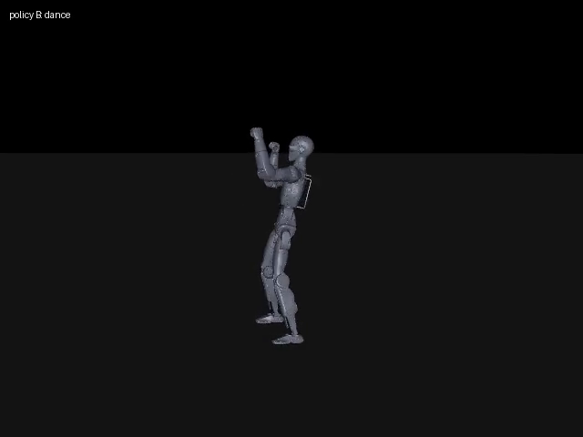
Tennis to dance, direct switch
One of the 20 runs, cut at the end of tennis
The label in the corner shows which policy is in charge. 32 s, plain MuJoCo.
Why it matters: a switch can work with no extra training: the robot starts far from dance's first pose and still recovers.
Notes:
**Time: 45 seconds.**
This is one direct switch. Watch the label: tennis is in charge, then dance takes over in one step. At the switch the robot is far from the pose dance starts from, yet it recovers and dances to the end. Why it matters: a switch can work with no extra training at all.

Slide 7
Did the switch survive?
Runs out of 20. Each policy alone survives 20 of 20.
from -> to | how I handed over | at A's end | cut 30 % | cut 50 % | cut 70 %
tennis -> dance | direct | 20 | 18 | 18 | 0
tennis -> dance | 1 s ramp | 19 | 20 | 20 | 19
tennis -> dance | via the stand | 18 | 20 | 19 | 19
dance -> tennis | direct | 20 | 20 | 20 | 20
dance -> tennis | 1 s ramp | 20 | 20 | 11 | 18
dance -> tennis | via the stand | 1 | 8 | 7 | 2
What failed
Direct: only the cut with the arm up mid-serve, 0 of 20.
The 1 s ramp raised that case to 19 of 20, but another case fell to 11 of 20.
Through the stand was the worst: down to 1 of 20.
Why it matters: in this test one cut (tennis at 70 %, arm up) failed every time: where the switch happens matters.
Notes:
**Time: 70 seconds.**
Here are all the numbers; the pink cells are the failures. The direct switch survived almost everywhere, except one case: tennis cut at 70 percent, when the arm is up in the serve, then zero out of 20. The one-second blend raised that case to 19 of 20, but another case fell to 11. And the idea I expected to be safest, going through the standing pose, was the worst: one out of 20 from dance to tennis. Why it matters: in this test, where the switch happens matters. This is two motions and a few cut points, so it is a first look, not a rule.

Slide 8
What the switch test told me
Four findings that shaped the rest of the week
The motions do not start or end standing
A direct switch mostly works, but not always
At the first and last frame the joints are far from the default standing pose. So I propose clips for the skill bag that start and end standing.
It failed when the arm was up mid-serve, far from the pose dance starts from.
The tested ramp was inconsistent
Motor springs alone did not hold the stand
It helped one case and hurt another. The policies never saw ramps or pauses in training, so a blended target is new to them.
In one test, holding the default pose without a policy, the robot tipped over in about 3 s. The stand between skills has to be a balancing policy. That is Part 2.
Why it matters: the stand in the middle of the bag must balance by itself, so I trained one next.
Notes:
**Time: 60 seconds.**
Four things. First, neither motion starts or ends at the standing pose, so I propose clips for the skill bag that start and end standing. Second, a direct switch usually works, but not when the robot is in an extreme pose. Third, the one-second ramp was inconsistent: it helped one case and hurt another, probably because the policies were never trained on blended targets. Fourth, and most important: in one test, holding the standing pose with only the motor springs tipped the robot over in about three seconds. So the stand between skills has to be a policy that balances. That led straight to part two.

Slide 9
PART 2
Walk and run on command
A policy that follows a speed command, and stands at zero
trained on the RTX 5080 workstation
Notes:
**Time: 10 seconds.**
Part two: walking and running, and standing still when the command is zero.

Slide 10
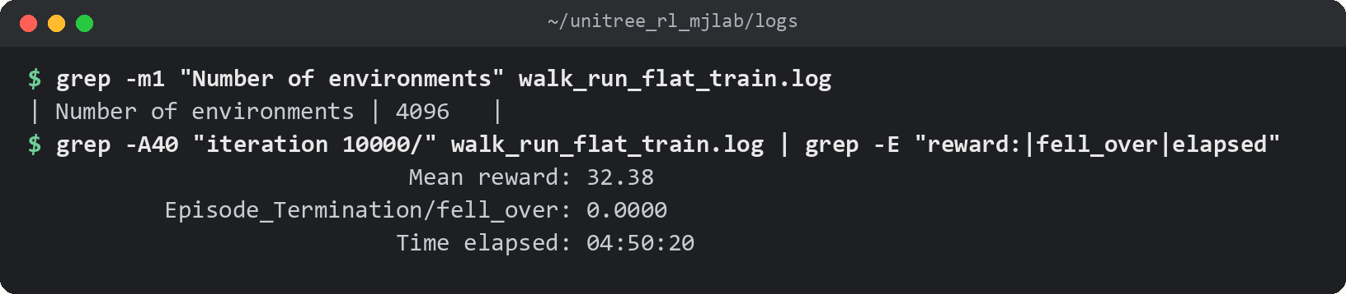
Where the walking policy came from
Unitree's own open-source training code, trained by me
Unitree's R1 task, my training run
One run, two policies
Unitree's open-source repo unitree_rl_mjlab has an R1 task that follows a speed command. I set it up in its own environment and trained it: 4,096 simulated environments in parallel, 10,001 iterations, 4 h 50 min.
Halfway through, the task raises the top forward speed from 1 m/s to 2 m/s. So one run gave me a walk (iteration 5,000) and a faster version (iteration 10,000).
Two earlier launches failed: one stopped when I closed the session, one trained a single simulated environment. I now check the environment count in the log right after launch.
Notes:
**Time: 65 seconds.**
I did not write this task myself. Unitree publishes an open-source training repo with an R1 task that follows a speed command. I set it up in its own environment, because it needs older library versions than my tracking work, and trained it on the 5080: 4,096 simulated environments in parallel, 10,001 iterations, just under five hours. The task raises the top speed from 1 to 2 meters per second halfway through, so one run gave me both a walk and a faster version. The terminal shows the real log: 4,096 environments, and at the last iteration none of them falls. Honestly, it took three launches: the first died when I closed the session, the second trained one simulated environment because I dropped a setting.

Slide 11
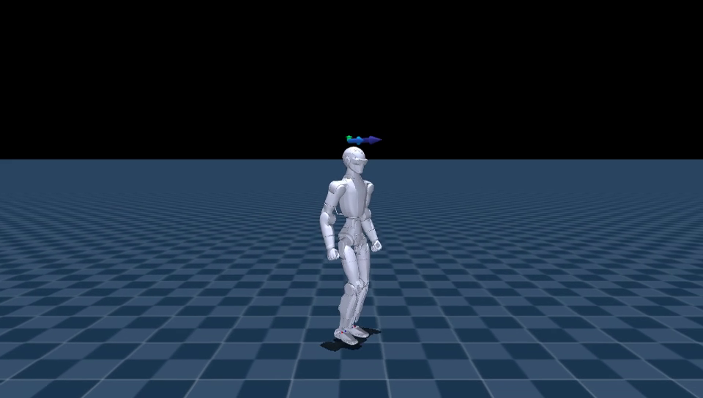
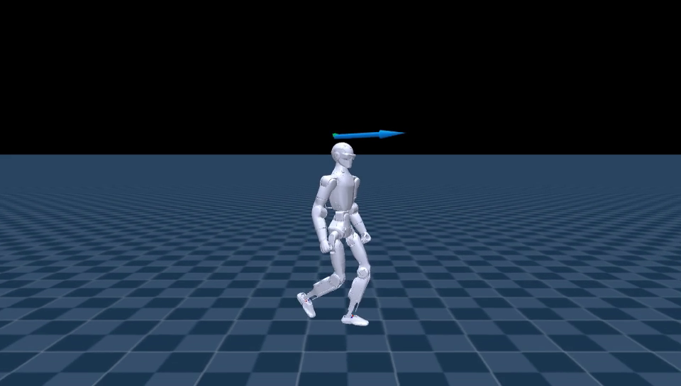
Walk and faster walk
Rendered in the training simulator; the speed command changes every 4 s
Walk (iteration 5,000): stand -> 0.5 -> 1.0 m/s -> stop, 16 s
Faster (iteration 10,000): stand -> 0.5 -> 1.0 -> 1.5 -> 2.0 m/s -> stop, 23 s
Why it matters: one policy covers standing, walking and walking fast, steered only by the speed I give it.
Notes:
**Time: 60 seconds.**
On the left, the walk: it stands, walks at half a meter per second, then one meter per second, then stops. On the right, the later checkpoint goes up to two meters per second and stops again. Near the end it seems to turn toward the camera. That is slow heading drift, about one and a half degrees per second, because nothing tells it to hold a heading. It is not a spin. Why it matters: one policy covers standing, walking and walking fast, steered only by the speed I give it.

Slide 12
How well it follows the speed command
Training simulator: 64 simulated runs per speed, average over the last 16 s of 20 s
command (m/s) | walk (it. 5,000) | faster (it. 10,000)
-0.5 (backwards) | -- | -0.43
0 (stand) | 0.00 | 0.00
0.5 | 0.47 | 0.45
1.0 | 0.96 | 0.96
1.5 | 1.44 | 1.51
2.0 | 37 of 64 fell | 1.98
2.0 m/s is a fast walk, not a run
Both feet are off the ground only 2.7 % of the time, so I call it a fast walk.
It stops without falling
From 2.0 m/s it needs 0.86 m to stop; from 1.0 m/s, 0.40 m.
At zero it stands still
192 simulated runs (64 per checkpoint), none fell, drift under 5 mm in 16 s. This is the stand the switch test asked for.
Why it matters: Within trained command cells, the largest speed gap is 0.07 m/s; the walk checkpoint falls at 2.0 m/s.
Notes:
**Time: 70 seconds.**
The numbers. These are 64 simulated runs per speed in the training simulator. Within the tested command ranges, the largest speed gap is 0.07 meters per second. The walk checkpoint was not trained above one meter per second; at two, 37 of 64 runs fall. The later checkpoint reaches 1.98. On the right, three plain facts. It is not really running: both feet are in the air only 2.7 percent of the time, so I call it a fast walk. It stops without falling. And at zero command it stands still: 192 simulated runs, 64 for each checkpoint, no falls, less than five millimeters of drift. That is the balancing stand the switch test asked for. Backwards is the least accurate. Why it matters: within the commands it was trained to follow, this is close speed control for a game.

Slide 13
A bug in Unitree's deploy file
Found in a CPU simulation that feeds the policy the way the real robot's code does
joint group | shipped | trained
legs and waist | 0.25 | 0.15
ankles | 0.25 | 0.3125
shoulder pitch, roll | 0.25 | 0.375
shoulder yaw, elbow, wrist | 0.25 | 0.4125
What I found
I wrote a second check in plain CPU MuJoCo that builds the policy's inputs like Unitree's C++ deploy code. In the parity check, the exported ONNX actor and trained Torch actor differed by at most 0.000002 (walk_run_eval_2026-10-22/README.md, section 5). This checks actor outputs only, not full deploy-input or hardware parity.
In this CPU simulation, with the deploy file Unitree ships, the robot fell in every walking run, usually within 2 s and always within 3 s.
The file scales every joint command by 0.25. Training scaled each joint group differently. I made a corrected copy (v1). For a first real-robot test I would also cap the speed at 1 m/s.
How much one unit of policy output moves the joint target, per joint group.
Why it matters: the shipped settings failed in this CPU simulation; the corrected file is ready for a later real test.
Notes:
**Time: 65 seconds.**
I wanted to check the policy using the input wiring in Unitree's C++ deploy code. In the parity check, the exported ONNX actor and trained Torch actor differed by at most 0.000002; that compares actor outputs only, not the full deploy inputs or hardware. The check is documented in the walk/run evaluation README, section 5. Then I found a mismatch in Unitree's shipped deploy file: it scales every joint command by 0.25, but training used a different scale per joint group, from 0.15 for the legs to 0.41 for the arms. In this CPU simulation, with the shipped file, the policy falls in every walking run, usually within two seconds and always within three. Why it matters: the shipped settings failed in simulation, before any real test. My corrected copy is ready for a later real test.

Slide 14
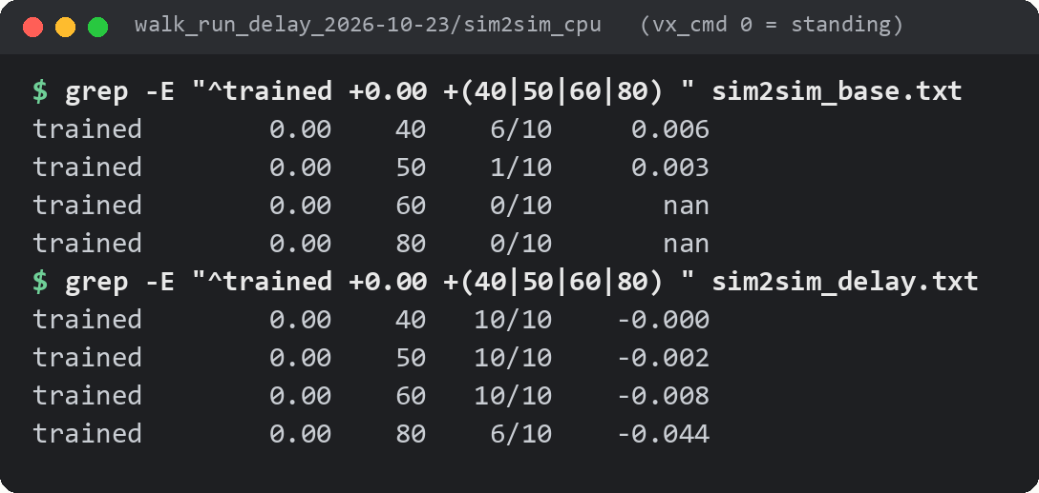
Standing was the weak skill under delay
So I applied the paper's recipe to the walking policy
The problem
With 40 ms of command delay, the walking policy fell while standing in 4 of 10 runs: a slow wobble that grows. Walking held up better than standing.
Delay arm
3,000 more iterations with a random 0-50 ms delay, as in the paper.
Standing (command 0), 10 runs per delay. Columns: delay in ms, runs survived, average speed.
Control arm
One fix on the way: the training library gave each joint group its own random delay. I set the simulation so all 24 joints share one delay, and checked it.
The same 3,000 iterations without delay: a matched comparison for the delay.
Why it matters: In this CPU simulation, standing was sensitive to the tested command delays; real-system delay is not measured here.
Notes:
**Time: 65 seconds.**
In this CPU simulation, the weakest skill under command delay was standing. At 40 milliseconds the base policy fell in four of ten standing runs. In the terminal, the top block is the base policy at zero speed and the bottom block is the delay-trained one. So I applied the paper's recipe: 3,000 more iterations with a random delay up to 50 milliseconds, and a control with the same 3,000 iterations and no delay. The control is a matched comparison: same extra training, no delay. One thing I changed on the way: this version of the training library gave each joint group its own random delay, so I set the simulation up so all 24 joints share one delay, and checked it. Why it matters: this shows how the stand handled the tested delays in this CPU simulation; actual delay on the R1 is not measured here.

Slide 15
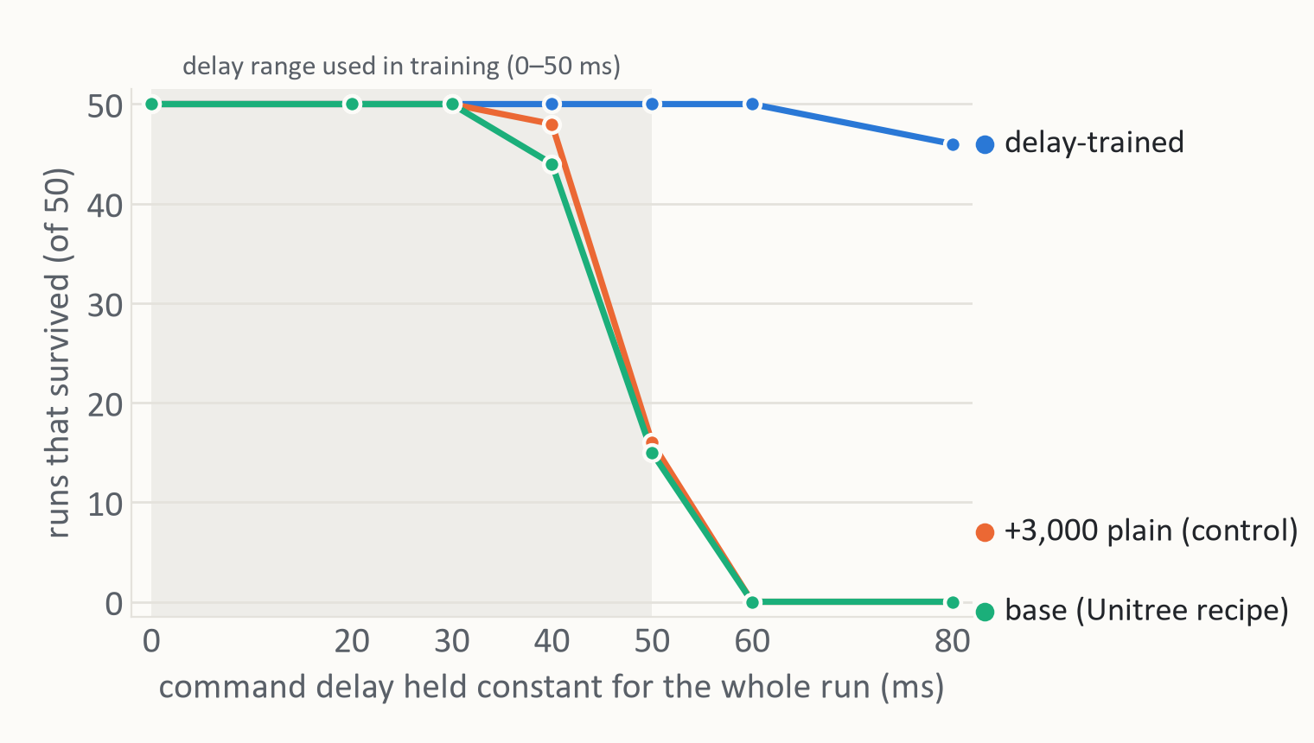
Delay training moved the limit past 60 ms
Runs that survived out of 50 (5 speeds x 10 runs), CPU check simulator
What the chart shows
Base and control fail between 40 and 60 ms.
The 3,000 extra plain iterations did not move the limit.
Delay-trained: 50 of 50 up to 60 ms, 46 at 80 ms. Its only failures are standing at 80 ms, 6 of 10 survived.
One training run (seed) per arm.
Why it matters: this run's matched control supports delay training as the reason; one seed, so more seeds are needed.
Notes:
**Time: 60 seconds.**
Here is the result. Each point is 50 runs, five speeds times ten. Green is the original, orange is the control with 3,000 extra iterations, blue is the delay-trained policy. Green and orange are nearly identical and fall apart between 40 and 60 milliseconds, so extra training alone did not help here. Blue survives everything up to 60 milliseconds and 46 of 50 at 80; the only failures are standing at 80. Why it matters: this run's matched control supports delay training as the reason, the same pattern as the paper. It is one seed per arm, so more seeds are needed.

Slide 16
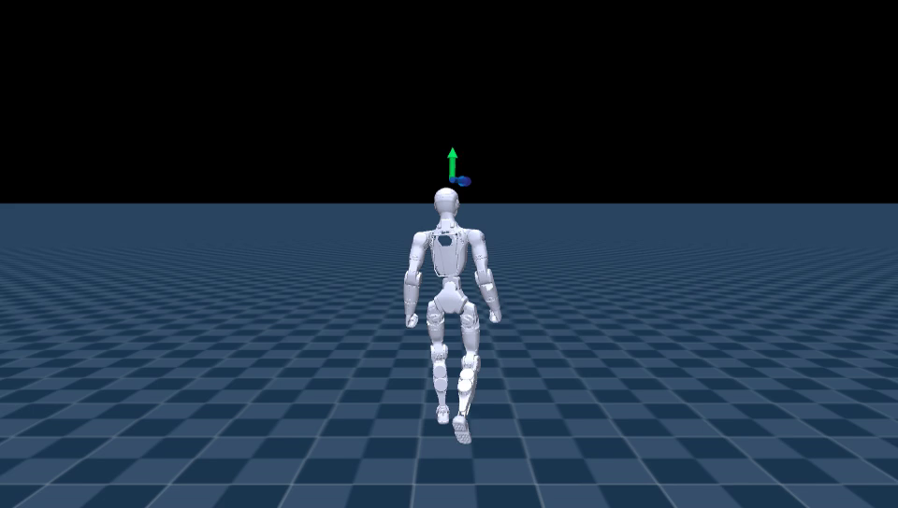
The delay-trained walk
Speed command 0 -> 0.5 -> 1.0 -> 1.5 -> 2.0 -> 0 m/s, 4 s each
What it costs
At a 2.0 m/s command it reaches 1.85 m/s, about 7.5 % below.
Backwards at -0.5 m/s it reaches -0.39, about 22 % below.
From 0 to 1.0 m/s it matches the others.
Delay-trained policy, training simulator, no falls
Why it matters: 1.85 vs 2.0 m/s forward and -0.39 vs -0.5 backward buy a 60 ms margin: my best simulated stand candidate.
Notes:
**Time: 55 seconds.**
This is the delay-trained policy, going from standing up to two meters per second and back, with no falls. It is not free: at a two meter per second command it reaches 1.85, about seven and a half percent below, and backwards it reaches minus 0.39 for minus 0.5, about 22 percent below. Up to one meter per second it matches the others. Why it matters: that trade buys a 60 millisecond margin at stand, so this is now my best simulated candidate for the stand in the middle of the skill bag.

Slide 17
PART 3
A jump from a video
Two stock clips through the unchanged pipeline
video -> GVHMR -> GMR -> mjlab training -> plain MuJoCo check
Notes:
**Time: 10 seconds.**
Part three: a jump, from a video, through the same pipeline as before.

Slide 18
Picking a clip
I downloaded 11 Pexels clips and checked each one
rejected | why
two "person jumping" clips | body cut off in every frame, camera moving
two jump-rope clips | framed from the waist up
gym clip | two people
trampoline | not flat ground
parkour leap | slow motion, so the timing is wrong
bed jumping | several people
Chosen
Jumping jacks: one person, whole body in frame, fixed camera, real flight, and it starts and ends standing.
Jump rope: fixed camera, small fast hops.
I found no clean clip of a single vertical jump.
Why it matters: the pipeline is only as good as the video: choosing the clip is half the work.
Notes:
**Time: 55 seconds.**
Picking the clip mattered more than anything else. I downloaded eleven clips and checked each. Most failed what GVHMR needs, as we saw last week: body cut off, a moving camera, more than one person, not flat ground, or slow motion. Jumping jacks was the best fit, and it starts and ends standing, which the switch test said we need. I added jump rope as a second, harder one. I did not find a clean single vertical jump.

Slide 19
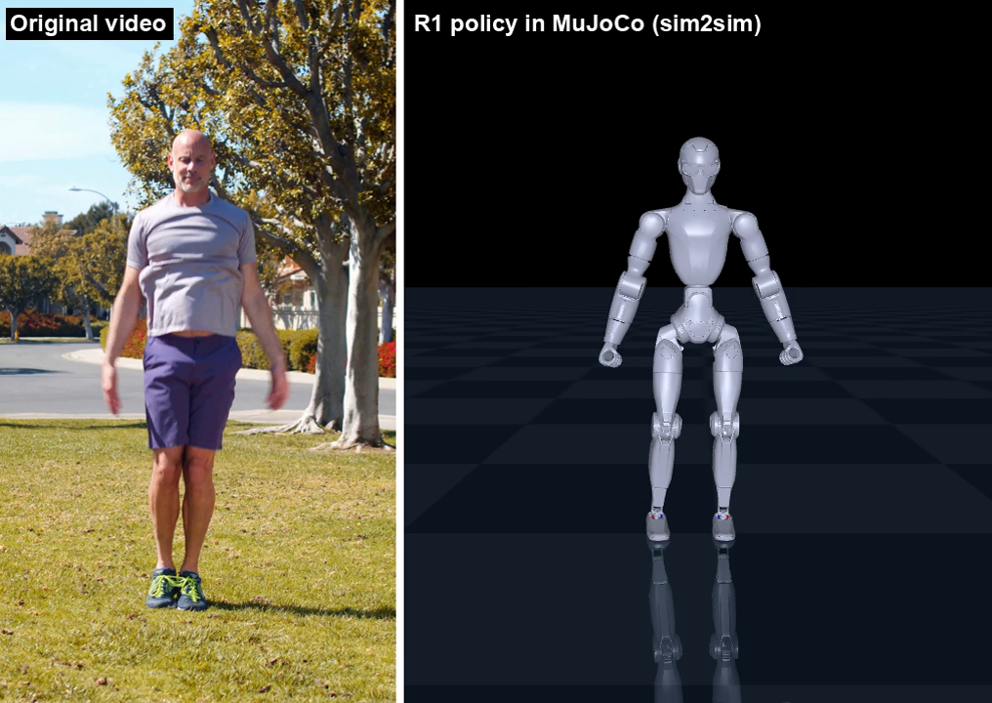
Jumping jacks: video next to the R1
10.4 s, about 10 jumping jacks (20 jumps)
Left: original video (Kindel Media, Pexels). Right: the delay-trained R1 policy in plain MuJoCo, frame-synced.
Why it matters: the bag has a simulated jump with a flight phase (both feet up 20 % of the time) that starts and ends standing.
Notes:
**Time: 50 seconds.**
Here it is: the original video on the left, the R1 on the right in plain MuJoCo, the second simulator, frame by frame. In the simulation it really leaves the ground: both feet are in the air 20 percent of the time. Why it matters: the bag now has a simulated jump with a flight phase that starts and ends standing.

Slide 20
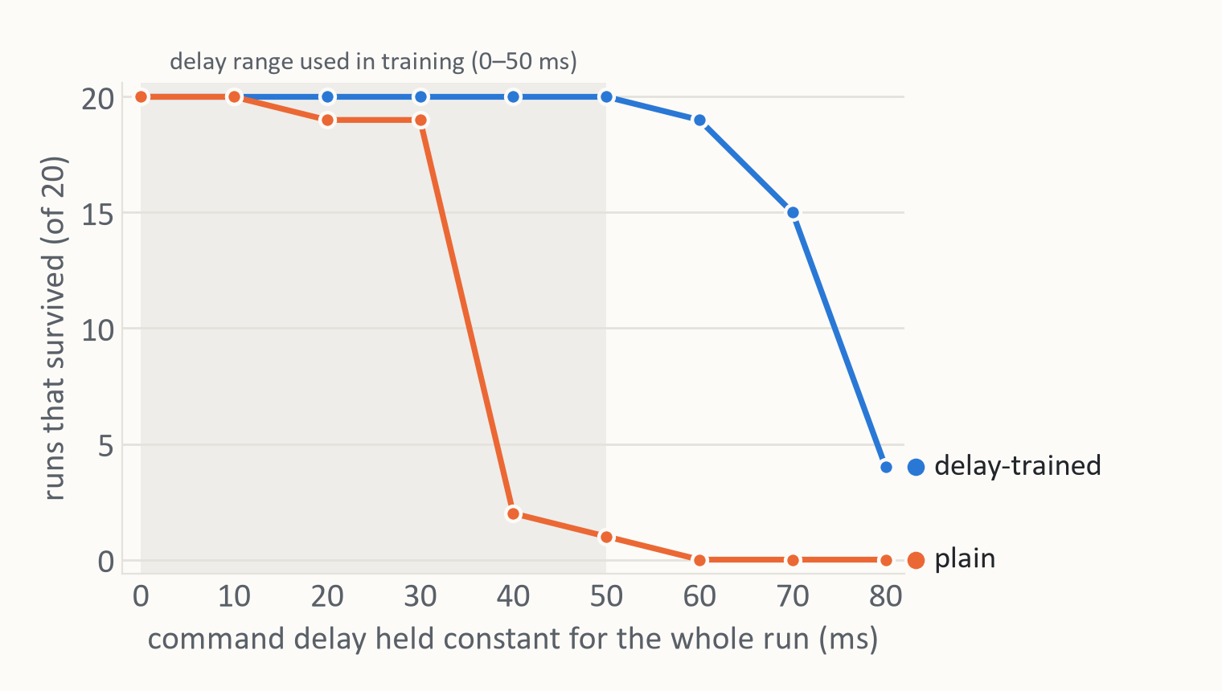
Jumping jacks under delay
Runs that survived out of 20, CPU MuJoCo: one fixed delay per run, plus the training's random changes
Same pattern as walking
Plain policy: 2 of 20 at 40 ms.
Delay-trained: 20 of 20 up to 50 ms, 19 at 60 ms.
Tracking
Average joint-angle error: about 34 degrees (0.59 rad) with no random changes.
Weak point: pushes
Three times stronger pushes: 8 of 20 without delay training, 11 of 20 with it. A push in the air cannot be corrected until the robot lands.
Why it matters: it improved in this run, like walking; one seed and 3,000 extra iterations, so the cause is not isolated.
Notes:
**Time: 55 seconds.**
This is the second simulator, with one fixed delay in each run plus the training's random changes. The plain policy falls apart at 40 milliseconds, two of twenty, and the delay-trained one holds 20 of 20 up to 50 and 19 at 60. Its weak point is pushes: with three times stronger pushes, 8 of 20 survive without delay training and 11 of 20 with it, because a push during flight cannot be corrected until the feet are down again. The average joint-angle error without random changes was about 34 degrees (0.59 rad). Why it matters: it improved in this run, like walking. But it is one seed, and the delay arm also got 3,000 extra iterations, so the cause is not isolated.

Slide 21
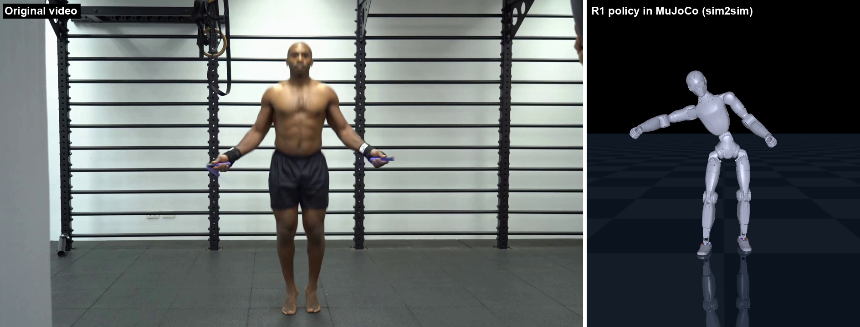
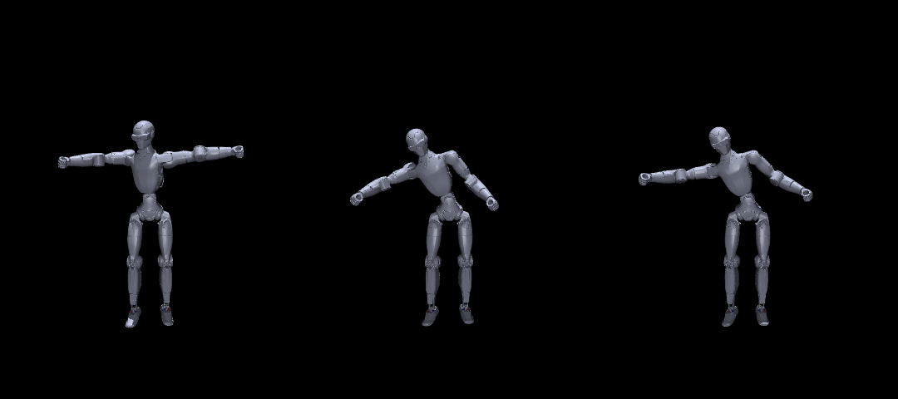
Jump rope: the robot follows a wrong reference
The problem enters before training
What went wrong
The person hops about 26 times. The robot barely leaves the ground (0.5 % of the time), holds its arms out to the sides and leans its torso.
I drew the reference motion by itself, with no physics and no policy. It already has the arms out. The policy is tracking a wrong target.
So the error comes from GVHMR, from GMR, or from both. I have not yet found which one. For the skill bag I use jumping jacks.
video and R1 policy, same moment
the reference motion by itself: no physics, no policy
Why it matters: check the copied motion first, before blaming training.
Notes:
**Time: 60 seconds.**
Jump rope did not work. The man keeps his arms down and turns the rope with his wrists; the robot holds its arms out and barely hops. Is that the policy's fault? I drew the reference motion by itself, with no physics and no policy, at the bottom, and the arms are already out. So the policy is faithfully tracking a wrong target. The mistake is before training: in GVHMR, which has to read small fast wrist motion with handles in the hands, or in the retargeting, or both. I have not isolated it yet. Why it matters: check the copied motion first, before blaming training.

Slide 22
What this does not show
The honest slide
Everything is simulation. Nothing ran on a real R1.
One training seed per arm for walk and run, and one per jump clip.
The switch test used two motions and policies trained without delay. "Survived" uses the training rules for a fall, which allow large joint error.
I have not yet tested switching from a motion policy into the walking policy's stand.
The "run" is a fast walk: both feet are in the air only 2.7 % of the time.
For the jump clips, the delay stage also adds 3,000 iterations. Only the walk control and the paper's seed study separate the delay from extra training.
The CPU check for walking has no pushes, sensor noise or rough ground.
Notes:
**Time: 60 seconds.**
What this does not show. All simulation. One seed per arm this week. The switch test is two motions with policies trained without delay. The key hand-off, from a motion into the walking stand, is not tested yet. The run is really a fast walk. For the jumps, extra training and delay are mixed; the walking control and the paper separate them. And the walking check has no pushes or rough ground.

Slide 23
Next
My plan, in order
1. Connect them
2. A better jump
3. Question for Prof. Sun
Switch from a motion into the delay-trained stand and back.
Then walk -> jumping jacks -> walk in one MuJoCo scene: the first piece of the game.
Draw GVHMR's body over the jump-rope video to find which stage goes wrong.
Find, or record on my phone, a clean vertical jump that starts and ends standing.
Before the gantry arrives, may I record the R1's own sensor stream (rt/lowstate) while it stays still, with no motion commands?
The corrected deploy file is ready for later, speed capped at 1 m/s.
Notes:
**Time: 60 seconds.**
Next, in order. One, connect the pieces: switch from a motion into the delay-trained stand and back, then walk, jumping jacks, walk, in one MuJoCo scene. That is the first piece of the game. Two, a better jump: find which stage breaks jump rope, and get a clean vertical jump, possibly recorded on my phone. Three, a question for you, Professor: before the gantry arrives, may I record the robot's own sensor stream while it stays still, with no motion commands? What that recording can tell us, and whether it is safe enough, are open questions I would like your view on.

Slide 24
References
Everything used or cited in this deck, with links
unitree_rl_mjlab (R1 walk/run task and C++ deploy)
Unitree Robotics, open source.
Code: github.com/unitreerobotics/unitree_rl_mjlab
My paper (L4DC 2027 submission)
Li and Sun, How Much Command Delay Can a Learned Humanoid Motion Tracker Tolerate? Delay Randomization and Sim-to-Sim Transfer. Under review.
mjlab (GPU training framework)
MuJoCo-Warp, Isaac-Lab-style API; the tracking task follows BeyondMimic.
Code: github.com/mujocolab/mjlab
Video-to-R1 pipeline (my code and all results in this deck)
Results folders dated 2026-10-20 to 2026-10-23.
Repo: github.com/SunCCNY/Embodied-AI/tree/main/Presentations/Shaoqin-Li/Video-to-R1%20Pipeline
GVHMR (video to SMPL-X human motion)
Shen et al., World-Grounded Human Motion Recovery via Gravity-View Coordinates. SIGGRAPH Asia 2024.
Code: github.com/zju3dv/GVHMR
Paper: arxiv.org/abs/2409.06662
Video clips (Pexels, free to use, credit given)
Elderly Man Doing Jumping Jacks Outside (Kindel Media); A Man Jumping Over The Skip Rope.
Jumping jacks: www.pexels.com/video/elderly-man-doing-jumping-jacks-outside-7299359/
Jump rope: www.pexels.com/video/a-man-jumping-over-the-skip-rope-4812842/
GMR (retargeting SMPL-X to the robot)
Araujo et al., Retargeting Matters: General Motion Retargeting for Humanoid Motion Tracking.
Code: github.com/YanjieZe/GMR
Paper: arxiv.org/abs/2510.02252
MuJoCo (the second simulator)
Google DeepMind physics engine.
Code: github.com/google-deepmind/mujoco
Notes:
**Time: 10 seconds.**
References, with links, for anyone who wants to follow up. The Pexels clips are credited to their creators and free to use.

